Slide 1
Welcome to CSE424 Final Presentation
Name: Sakib Rayhan Yeasin
ID: 24341218
Section: 2

Slide 2
Paper Title
Railway Track Fault Monitoring Using Deep Learning: An Efficient Approach to Modernizing Defect Detection

Slide 3
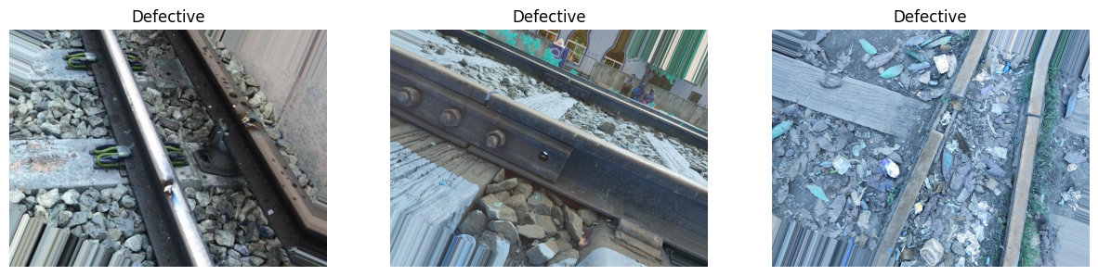
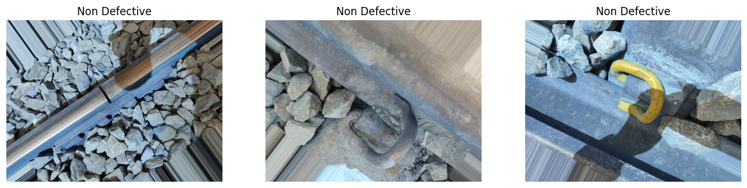
Dataset Overview
Image Classes:
Defective
Non Defective

Slide 4
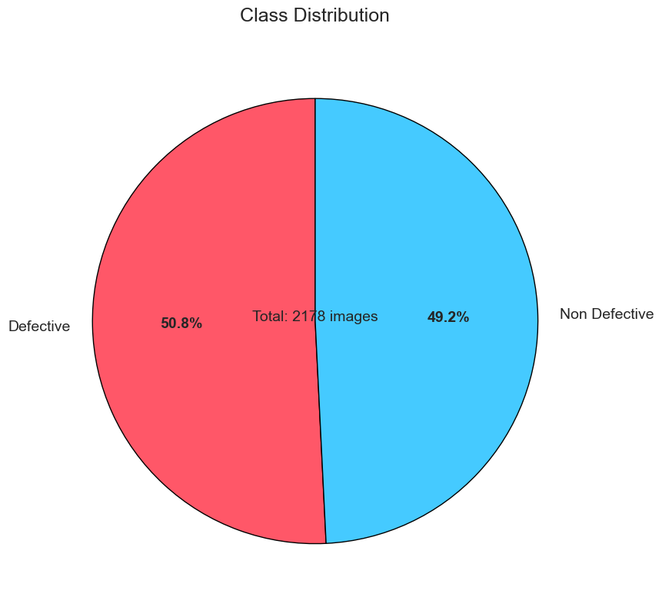
Dataset Overview
Dataset Balance Check
After Merging 3 Datasets:
Number Defective Images: 1106
Number Non Defective Images: 1072
Total Images: 2178
Imbalance Ratio: 1.03 : 1

Slide 5

Dataset Overview
01
02
03
04
No Duplicate Images Found
All images in the dataset are unique, ensuring model training won’t be biased by repeated samples.
No Corrupt Images Found
All files are readable and properly formatted
No Unusual Images Detected
No images are excessively dark, bright, or low contrast
Pixel Value Range: 0 to 255
Pixel values appear to be in STANDARD RGB format

Slide 6
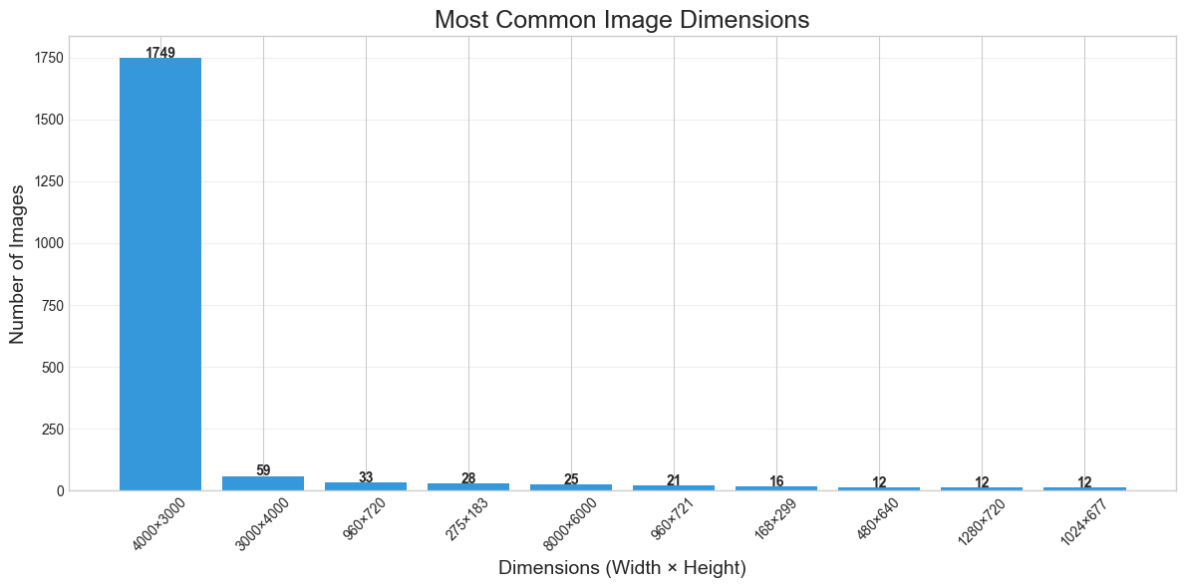
Dataset Overview
Image Dimensions (Top-5)
Height | Width | Count
4000 | 3000 | 1749
3000 | 4000 | 59
960 | 720 | 33
275 | 183 | 28
8000 | 6000 | 25
Total Unique Dimensions: 38

Slide 7
Methodology
1st step
Data Splitting
2nd step
Data Pre-processing
5th step
Model Evaluate
3rd step
Data Augmentation
4th step
Model Build, Compile, Fit

Slide 8
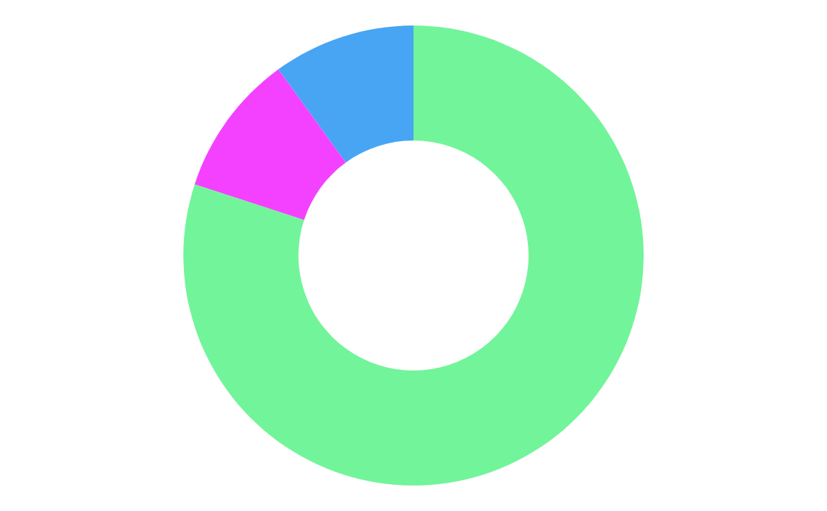
Data Splitting
Original Dataset (100%)
├── Defective/
│ ├── image1.jpg
│ ├── image2.jpg
│ └── ...
└── Non Defective/
├── imageA.jpg
├── imageB.jpg
└── ...
After Splitting (80-10-10):
Splitted Data/
├── Train/ (80%)
│ ├── Defective/ (80% of original defective images)
│ └── Non Defective/ (80% of original non-defective images)
├── Val/ (10%)
│ ├── Defective/ (10% of original defective images)
│ └── Non Defective/ (10% of original non-defective images)
└── Test/ (10%)
├── Defective/ (10% of original defective images)
└── Non Defective/ (10% of original non-defective images)
Validation Set
10%
Test Set
10%
Train Set
80%

Slide 9
Data Pre-processing
Resizing & Cropping
All images are resized to 224×224 pixels to match the model's input size.
Tensor Conversion
Converts images into PyTorch tensors for model compatibility
Normalization
Used ImageNet mean and std to standardize pixel values, which helps in faster convergence during training

Slide 10

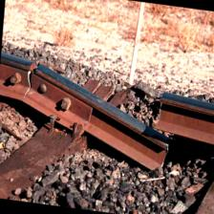
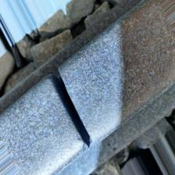
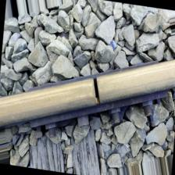

Data Augmentation
Traditional Augmentation
Augmentation using GAN (cGAN)

Slide 11
Model Selection
Model 1 | InceptionV3
Model 2 | ResNet50V2
Model 3 | ConvNeXt-Tiny

Slide 12
Model Build
1. Handling Class Imbalance
Computed class weights using compute_class_weight from scikit-learn.
Applied during training to balance the influence of each class.
2. Model Architecture
Base Model + Custom Head (e.g. Global Average Pooling, Dense, Batch Normalization, ReLU, Dropout layers etc)

Slide 13
Model Compile and Fit
3. Transfer Learning Strategy
Phase 1: All base model layers frozen (only custom head trained)
Phase 2: Last 30 layers unfrozen for partial fine-tuning
Phase 3: All layers unfrozen for full fine-tuning
Used progressively lower learning rates for each phase
4. Training Setup
Loss: Binary Cross Entropy
Optimizer: Adam (LR: 0.001 → 1e-5 → 5e-6)
Metrics: Accuracy and F1 Score
5. Callbacks Functions
EarlyStopping: Monitors val_f1_score, restores best weights
ReduceLROnPlateau: Lowers LR on plateau of validation loss
ModelCheckpoint: Saves best model based on val_f1_score

Slide 14
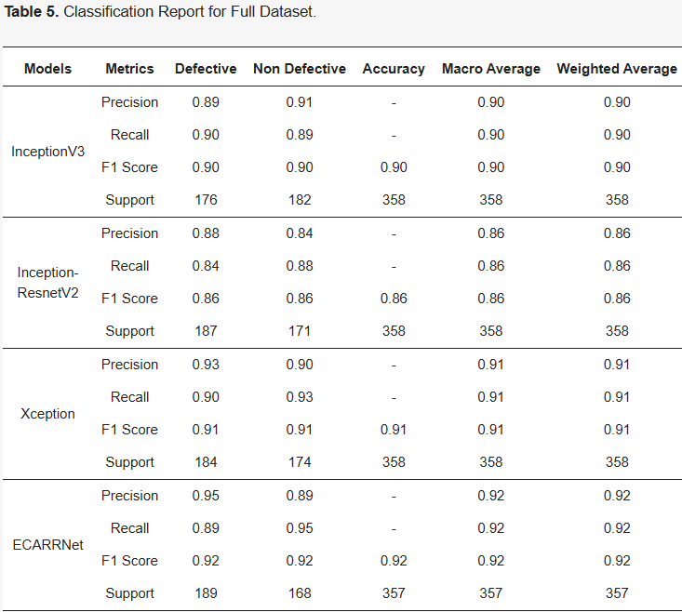
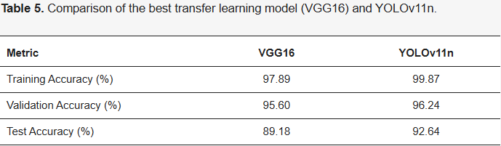
Accuracy?
Previous Work
Source: Paper 2
Source: Paper 1

Slide 15
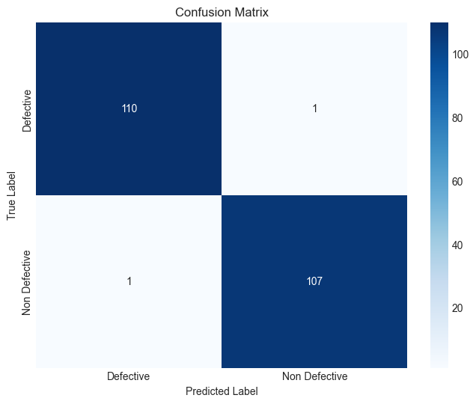
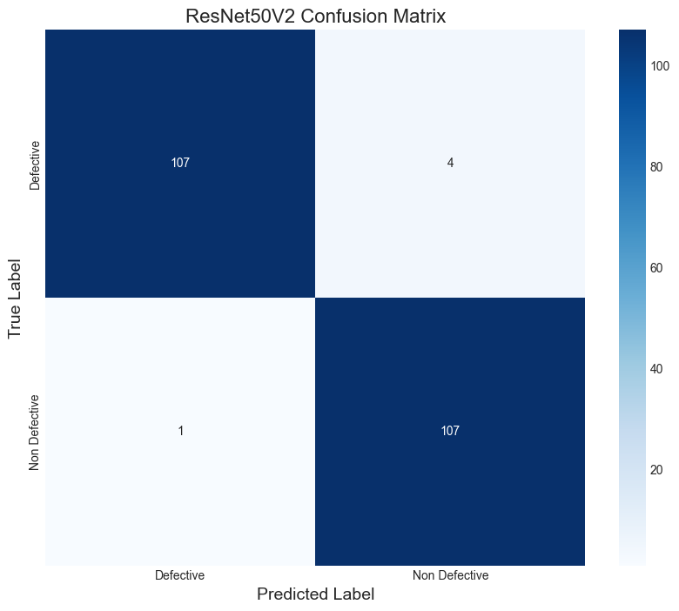
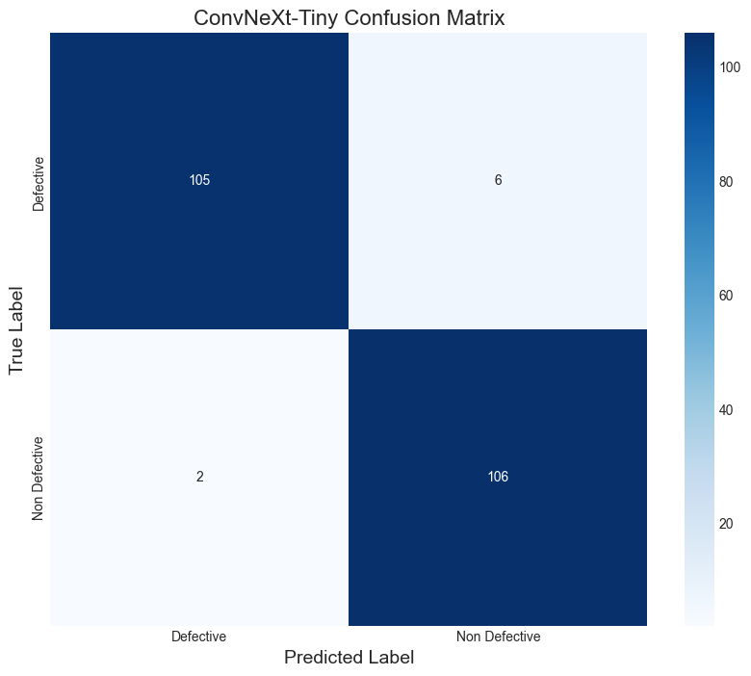
Model Evaluate
Model | InceptionV3 | ResNet50V2 | ConvNeXt-Tiny
Test Loss | 0.03 | 0.05 | 0.15
Test F1 Score | 0.99 | 0.98 | 0.96
InceptionV3 ResNet50V2 ConvNeXt-Tiny

Slide 16
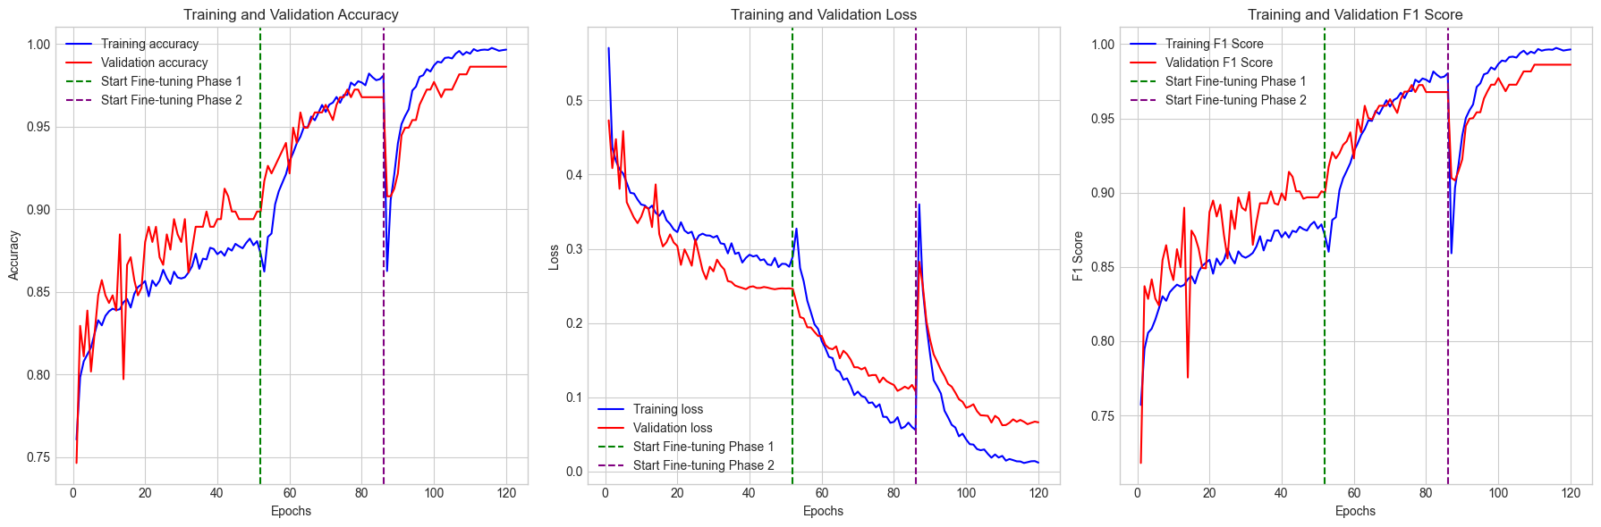
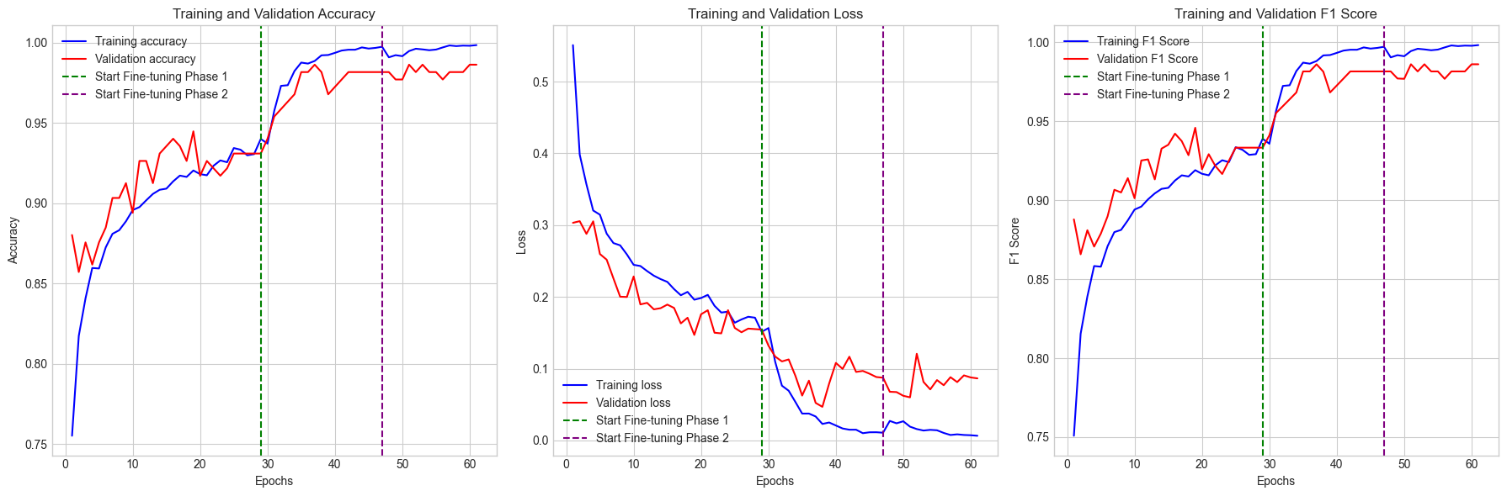
Training History Plot
InceptionV3
ResNet50V2

Slide 17
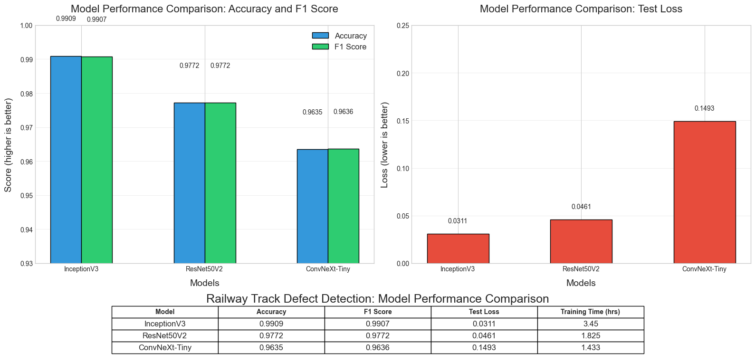
Model Comparison

Slide 18
Which Model is Best?
InceptionV3 is more balanced — it achieves high precision, recall, and F1 for both classes.
ResNet50V2 shows a trade-off:
High precision for Defective, but lower recall → might miss some defects.
High recall for Non-Defective, but lower precision → might raise false alarms.
Metric | InceptionV3 | ResNet50V2
Precision | 0.99 / 0.99 | 0.99 / 0.96
Recall | 0.99 / 0.99 | 0.96 / 0.99
F1-Score | 0.99 / 0.99 | 0.98 / 0.98
InceptionV3 has Lower Params (~23.9M vs. ~27M)
Training Time Consideration
ResNet50V2 is faster (~1.8 hrs vs. 3.45 hrs).
But Since training is done very rarely, the training time is not a major concern.
🏆 InceptionV3 is the best model overall

Slide 19
Future Work
01
02
03
04
Real-Time Detection on Edge Devices
Optimize and deploy the model on edge devices (e.g., Raspberry Pi, Jetson Nano) for real-time fault detection in trains.
Automated Reporting System
Build a pipeline that not only detects faults but also generates a report with location, image, type of defect, and urgency level.
Multiclass Defect Categorization
Instead of just binary classification, classify specific defect types (e.g., crack, wear, missing fastener, deformation).
Larger and Diverse Dataset
Improve robustness by collecting more data from different weather, lighting conditions, and regions (snow, rain, rural, urban).

Slide 20
Reference
Dataset
https://doi.org/10.34740/kaggle/dsv/2772290
https://doi.org/10.34740/kaggle/dsv/1884733
https://doi.org/10.34740/kaggle/dsv/3108310
Papers:
https://doi.org/10.3390/infrastructures10010003
https://doi.org/10.3390/ai5020024

Slide 21
Thank You
Any Questions ?

